Slide 1
The 6 pathways for brewing around the world since beer inception.
Under this seemingly presumptuous title, only the brewing techniques will be discussed. Beer results from the saccharification of starch and simultaneous or sequential alcoholic fermentation. Mankind has brewed beer with all sources of starch: cereals, tubers, starchy roots and fruits, tree marrow (sago palm), etc. It has used 6 methods to saccharify starch: 5 are biochemical (saliva, germination, amylolytic fungus, amylolytic plant, over-ripening), one is chemical (acid medium). These 6 methods have been and are used today on all continents. A classification of these techniques may be of interest to archaeology and the search for artefacts specific to each brewing method.
1. The 6 brewing pathways stem from the diversity of starch sources.
Technically, beer differs from wine in its origin: starch. Starch does not ferment spontaneously. It has to undergo several transformations before providing fermentable sugars. In its natural state, starch is stored by plants in the form of granules. A cooking process must release the contents of the starch granules, which then become a starchy paste. In a starchy paste, the released macromolecules of starch can undergo the enzymatic action of amylases. This is the second transformation: the hydrolysis of polysaccharides into simple, fermentable sugars (glucose, maltose).
This last operation is the root of the 6 beer brewing pathways, in fact 6 methods of starch saccharification. Five of them are based on enzymatic action, the 6th method on a chemical action.
Christian Berger
1
2021

Slide 2
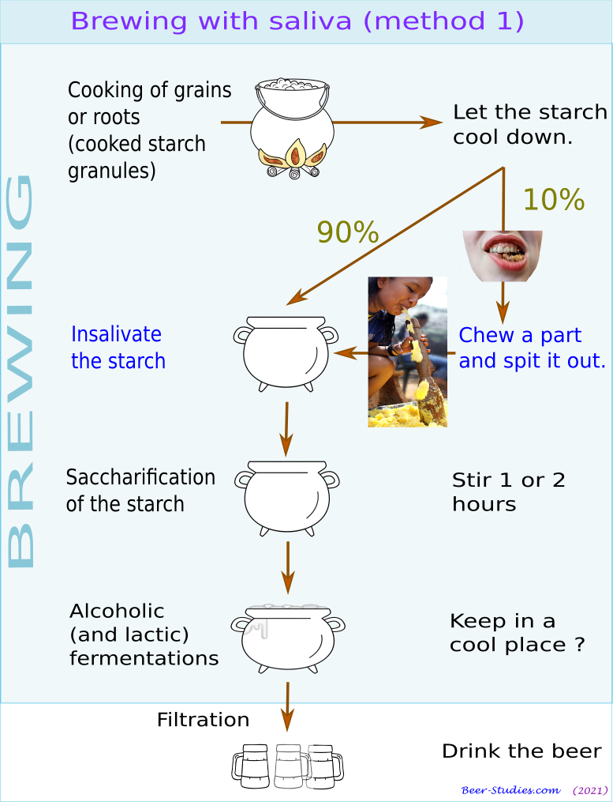
Brewing method no 1: the salivary amylases.
Human and some mammalian saliva contains a powerful enzyme, the ptyalin. Chewing or swallowing lumps of cooked starch is a very effective method of saccharification. The process is fairly simple.
A portion of the cooked starch (approx. 5-10%) is chewed, heavily insalivated and spat out into the 90% mash. The action of the ptyalin is sufficient to saccharify the whole.
The liquefaction of the mash and its sweet taste serve as criterions for moving on to the phase of spontaneous or induced alcoholic (and lactic) fermentation.
This brewing method is well documented for the making of the maize, cassava, quinoa, and sweet potato beers in South and Central America. It has been used until recent times by the indigenous peoples of Taiwan, or Hokkaidô-Sakhalin (Ainu) among others, and in more distant past by most Asian peoples.
Christian Berger
2
2021

Slide 3
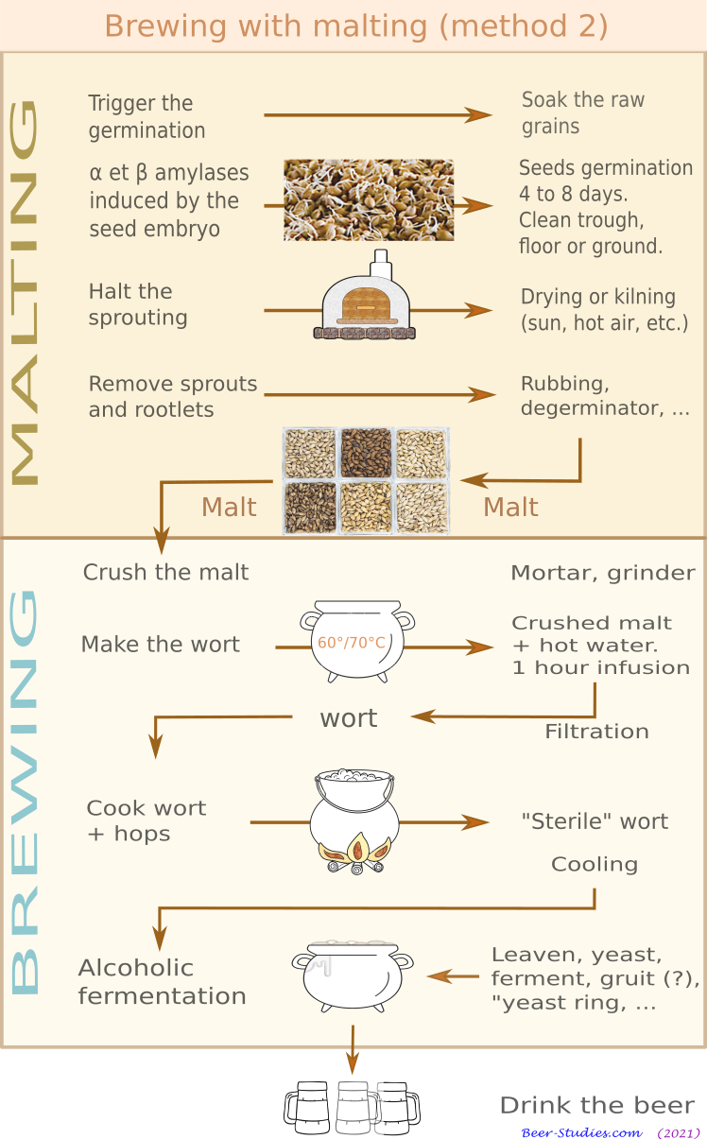
Brewing method no 2 : the amylases from cereal grains.
The germination of cereal seeds naturally generates amylases, among other enzymes, which convert the starch in the albumen into sugars. Here, there is no prior cooking. Proteolytic enzymes break down the starch granules. This method, which is as old as insalivation, refers to the making of malt.
After 4 to 7 days of germination, the drying of the grains stops all enzymatic action. The resulting grain is the malt. Dry and degerminated, the malt grains can be kept for a long time (several years) until the moment of the actual brewing by infusion or decoction of the crushed malt in hot water.
Christian Berger
3
2021

Slide 4
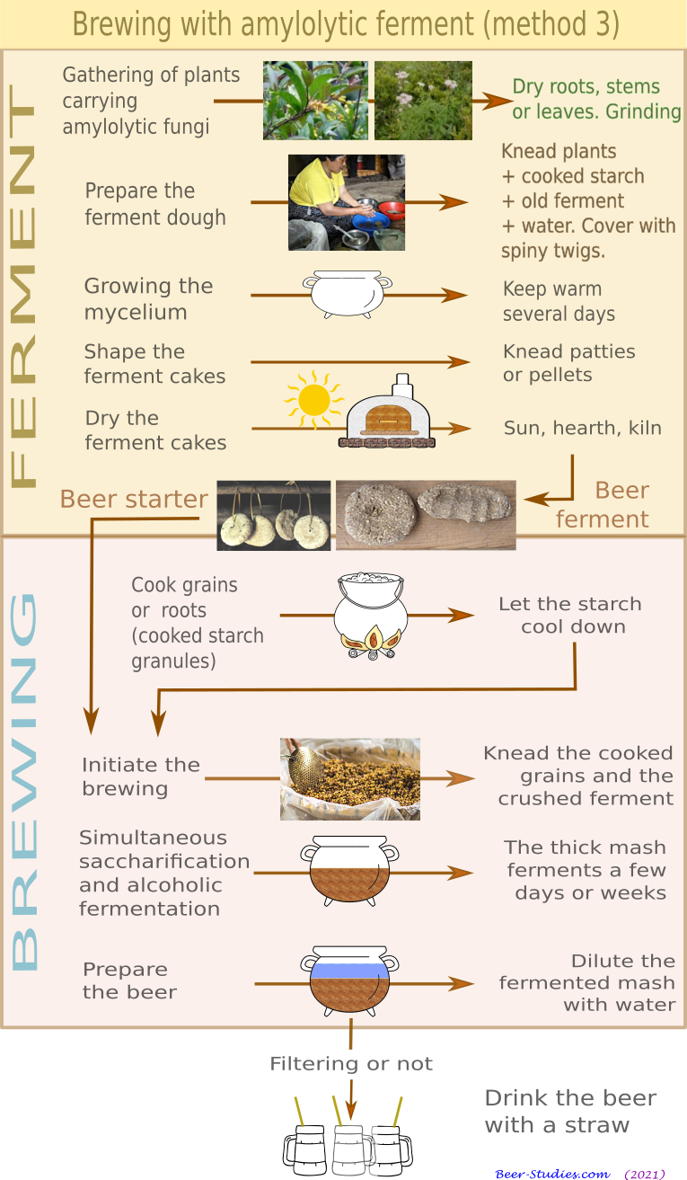
Brewing method no 3: the amylases of certain fungi.
Some microscopic fungi produce amylases (Aspergillus, Mucor, Rhizopus, Monascus, Amylomyces rouxii, Penicillium, etc.). The method grows the mycelium of these fungi on a cooked starch substrate. The fungi are collected from plants by bringing some of their organs (roots, stems, leaves) into contact with the cooked starch.
When the mycelium has developed, one shapes pellets with the starch covered with mycelium. These are then dried and preserved. They are called beer starters in Anglo-Saxon literature.
To brew, you simply mix them with a mass of semi-solid cooked starch. These cultivated mushrooms also have an aerobic metabolism that converts sugars into alcohol. When this semi-solid mass is sufficiently saccharified and fermented, water is added to get beer. Most of the process takes place in a semi-solid phase (no wort step).
Christian Berger
4
2021

Slide 5
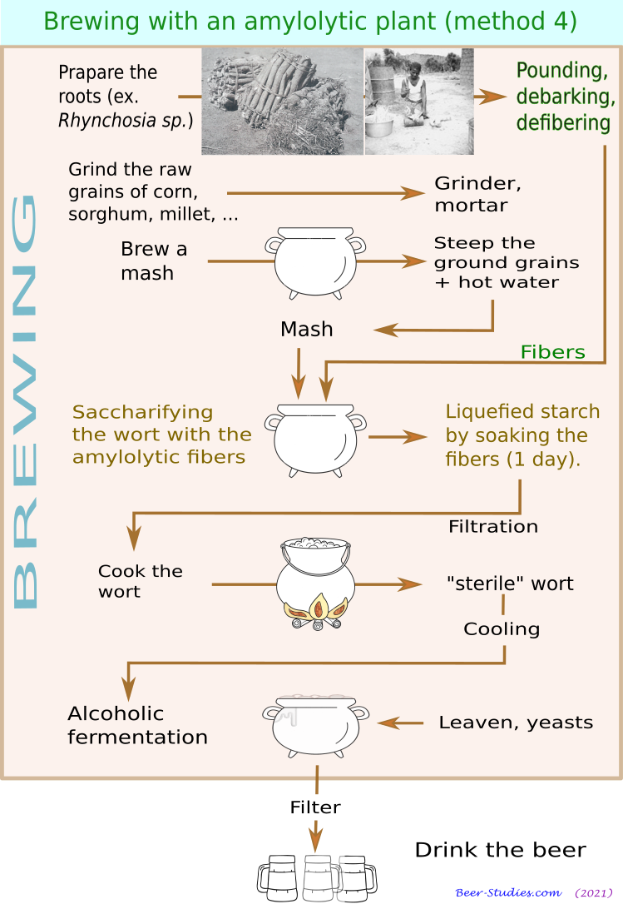
Brewing method no 4 : the amylases from some plants.
Some plants hold powerful saccharifying enzymes in their roots or aerial organs: roots of the genera Eminia, or Rhynchosia, stems of the liana Abrus pulchellus, leaves of Boscia senegalensis, etc.
The brewing process entails macerating these plants in a slurry of cooked and unmalted grains. The enzymes hydrolyse the cooked starch. The mash becomes sweet and fermentable.
This method is quite similar to malting. The origin of the saccharifying enzymes is endogenous (sprouted grains) for malting. Here it is exogenous (saccharifying vegetable fibres). This method is therefore suitable to brew beer with all starch sources: cereals but also tubers (manioc, yams, etc.).
Christian Berger
5
2021

Slide 6
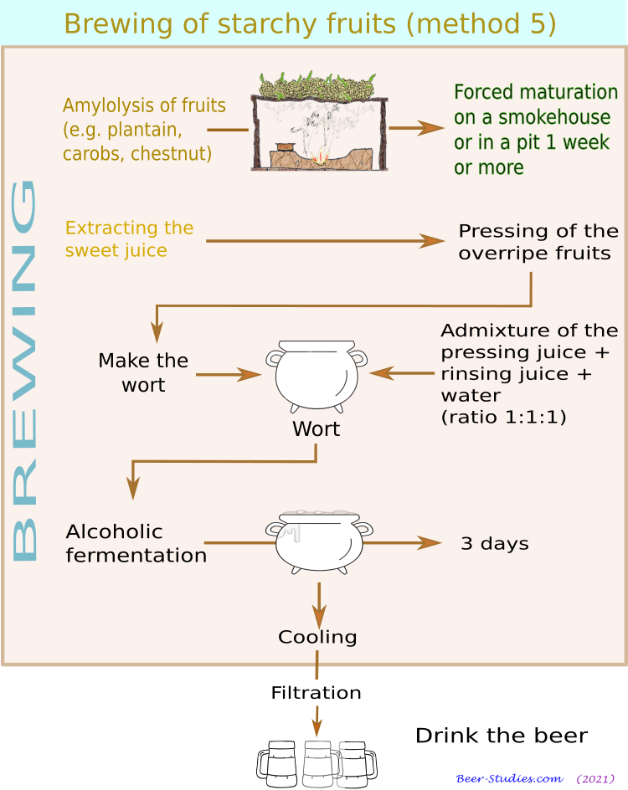
Brewing method no 5: the amylases from starchy fruits.
Starchy fruits have their own saccharifying enzymes (plantain, carob seed, chestnut, Pandanus julianettii seed in Papua, etc.). The same applies to tubers such as taro, yams, manioc, etc.
The activation of these enzymes requires hydrating the starch of these fruits or tubers, and sealing them in an enclosed area to allow the temperature to rise. The exothermic enzymatic activity causes them to over-ripen, that is, to saccharify the starch.
The starch is liquefied by these endogenous amylases. The sweetened mash must then be pressed and diluted (x3) with water to obtain a sweet juice. This juice ferments more or less spontaneously thanks to the yeasts naturally found on these same fruits.
Christian Berger
6
2021

Slide 7
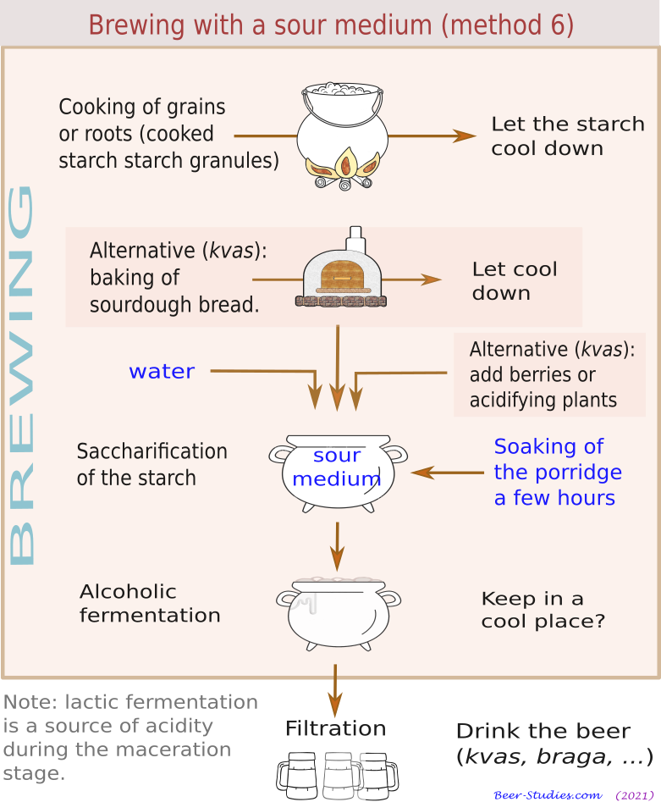
Brewing Method no 6: a sour medium.
A starchy slurry can be converted into simple sugars by a strong acid medium (pH < 4). This purely chemical technique is used in industry to produce cheap glucose.
This method characterises the brewing of kwas in Russia and braga in Central Europe, starting with a simple infusion of breaded cereals with the addition of berries (blackberry, lingonberry, redcurrant, etc.) or acidic fruits which serve as acidifying agents. It also allows beer to be brewed with the pith of the sago tree in Indonesia.
More generally, the involvement of lactic acid fermentation in traditional brewing methods around the world implies that acid hydrolysis plays an important role. It is involved in brewing beers in regions where pastoralists and farmers have historically coexisted (Central Asia, Eastern and Northern Europe, Tibet, Sahel, etc.). Fermented milk and starch are cousin beverages.
Christian Berger
7
2021

Slide 8
2. The 6 pathways of brewing implemented in all regions of the world.
Until recently, historians assigned each brewing method to a region of the world or a "civilisation": malting for Europe or Africa, amylolytic ferments for China (jiu), Japan (sake), Korea (taekju) or Southeast Asia, insalivation for the maize beers of the Incas (chicha) or the cassava beers of the Amazon, acid hydrolysis for Russia (kwas) or Central Europe (braga). Each subcontinent would have developed its own method. As regards insalivation, declared to be a primitive method, it was said to be an archaic stage of brewing, practised everywhere and now almost extinct. The indigenous peoples of South America and Taiwan are said to be the witnesses-relics to this so-called archaic method.
The data of the last 4 or 5 decades have changed this simplistic picture.
The No. 3 amylolytic ferments method is attested well beyond its 'classical' territory (Far Asia, South-East Asia). The kinva beer ferment has been used in India since the Maurya Empire (320-185 BC). Beer starters are used in Northern India, in Africa (Congo, Gabon) and in South America (Ecuador, Venezuela, Guyana, Surinam) and Central America (Caribbean).
The No. 4 amylolytic plants method has a much wider African range than Zambia and south-eastern Congo where it was discovered and described in the 1970s (munkoyo beer). It is used in Senegal today.
The No. 6 acid hydrolysis method covered large areas in the Balkans during the time of the Ottoman Empire, to name just one region close to Europe. It is nowadays widely used in Russia and Eastern Europe. Moreover, we can link to this method the brewing of carob beer (Argentina, Chile, Paraguay), and probably the brewing in Europe since the Neolithic period.
Historically, these 6 methods are neither independent nor isolated from each other. They coexist geographically and chronologically. Their regional or continental specialisation is a recent historical evolution (example of malting in Europe). The purely technical classification of brewing methods pins down their main features, which makes it possible to locate them in textual or archaeological documentation.
Christian Berger
8
2021

Slide 9
3. Differentiated archaeological traces depending on the 6 ways of brewing in Europe?
Traditionally in Europe, archaeologists have studied beer with only malting and its artefacts as a technical background: prepared vats or floors for soaking and sprouting grains, crushing tools (crumbly malt does not require milling), cooking devices, sprouted grains, analysis of sprouting traces under an electron microscope (whole grains, starch granule structure), traces of fermentation in pottery (calcium oxalate). Thanks to this approach, it was possible to draw up a map of about 80 witness sites covering the Neolithic to the Iron Age(beer-studies.com/fr/Histoire_generale ...). Provisional list.
What opportunities do other brewing methods in Europe offer?
1. Insalivation is typified by the presence of human DNA on starch residues found in brewing traces and the absence of germination. This DNA is unlikely to have been retained unless in a case of uncooked mash after its saccharification. The differential degradation of starch by ptyalin versus α and β amylases has not been studied to my knowledge. This could be a promising approach.
2. The amylolytic ferments: a promising lead. In 2020, Li Liu's team in China identified sporangia of Mucor and Aspergillus among starch granules sampled from beer jars (Dingcun ‑4500. doi.org/10.1016/j.jasrep.2019.102134). This method coexists in ancient China with malting (millet, barley, wheat) and tuber brewing: snake gourd(Trichosanthes kirilowii), lily bulbs (Lilium sp.) and yams (Dioscorea sp.) (Mijiaya ‑2500, doi.org/10.1073/pnas.1601465113). Hence, 3 different methods on the banks of the Huang-He River between 4500 and 2500 BC, well before the Shang dynasty, the classic documentary horizon of the history of brewing in China. A 2021 discovery at the Qiaotu site provides the same data and a much earlier date (7000 BC) doi.org/10.1371/journal.pone.0255833.
Christian Berger
9
2021

Slide 10
3. The amylolytic plants for beer brewing raise the problem of their identification. To my knowledge, there is no database of these plant species. One must necessarily go through experimental archaeology to identify and ascertain their very special properties. The same applies to plants that carry amylolytic fungi. But once identified and associated with other brewing indicators, they would be a good clue of the use of alternative methods to malting in Europe. The case of gruit is very interesting. This mixture of plants used to brew cerevisia during the early Middle Ages is quite well documented.
4. Starchy fruit and over-ripening: a very problematic pathway for brewing to follow. For example, a chestnut porridge differs from a chestnut beer only by its maceration time and its acidification, which favours saccharification and the work of yeasts. Only experimental archaeology can provide samples and spectrometry detect specific chemical compounds.
5. Acid hydrolysis produces beers with coarsely ground raw starch or crushed bread, in the presence of yeast and lactic acid bacteria. The combined presence of acidifying berries is a clue, not a proof (e.g. cranberries in the Egtved tomb). Again, only a differentiated degradation of the starch granules observed under the electron microscope can identify this method, or more likely, the combination of this method with the other five pathways.
In short, there are some great discoveries in prospect. The archaeology of beer is in its infancy and beer has not yet whispered its final say!
Christian Berger
10
2021

Slide 11
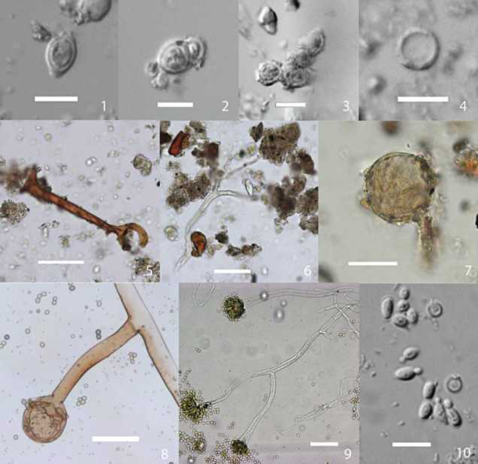
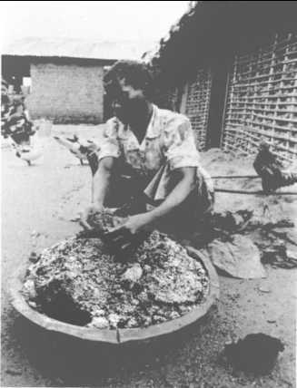
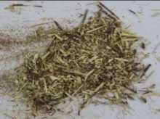
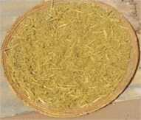
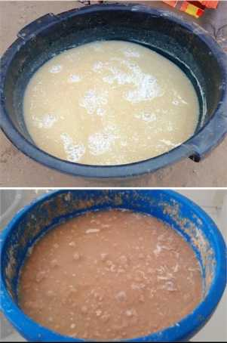
Mould-fermented rice used to brew maize or cassava beer (Songola woman, upper Congo River, RoC)
Dingcun samples 1,2: yeast cells in budding process; 3: a cluster of yeasts; 4: spore (1–4 compared with 10); 5: sporangia with sporangiophore (compared with 8, Mucor sp.); 6: branched sporangiophore with sporangia (compared with 9, Aspergillus oryzae); 7: sporangiophore with sporangia, unidentified. Modern reference 8: Mucor sp.; 9: A. oryzae; 10: S. cerevisiae yeast cells in budding process (oval) and Aspergillus spores (round) (scale, 1–4,10: 10 µm; 5–9: 50 µm).
Abrus pulchellus lianas ans stems of Boscia senegalensis crushed to saccharify the wort of the boumkaye beer or the nieniebane beer (Senegal).
Ankei Takako (1996). http://ankei.jp/takako/file/ 1307/001879 1.pdf
Cissé Oumar Ibn Khatab (2020), Les boissons fermentées traditionnelles du Sénégal : diagnostic des procédés, études de la maturation et essais de
stabilisation.recherche.esp.sn:8080/ xmlui/handle/123456789/234_
Li Liu, Yongqiang Li, Jianxing Hou (2020), Making beer with malted cereals and qu starter in the Neolithic Yangshao culture, China (fig. 4)
Christian Berger
11
2021

Slide 12
Some links on beer-studies (free use of content, unless explicitly stated)
The 6 brewing methods with the diagrams displayed here:
beer-studies.com/en/Fundamentals/Six-brewing-pathways
Archaic beers (archaeological records for China, Egypt, Western Asia, Europe, South America): beer-studies.com/en/world-history/Birth-of-brewing/Archaic-beers
The foundation of primitive combined fermented beverages:
beer-studies.com/en/world-history/Birth-of-brewing/Combined-fermented_beverages
The amylolytic ferments in ancient India: beer-studies.com/en/world-history/First-empires/Indian-Maurya-empire/Trade-ferments-dregs
The file of the gruit (Middle Ages) : beer-studies.com/en/Avanced-studies/carolingian_brewing
The beers brewed by acid amylolysis in the Ottoman Empire:
beer-studies.com/en/world-history/Beer-and-religions/Islam-alcohol-prohibition/Beer-tradition-ottoman
The amylolytic ferments in Africa: beer-studies.com/en/explorer?chrono=500&geo=85&theme=220
The amylolytic plants in Africa: beer-studies.com/en/explorer?geo=84&chrono=505&theme=517
A bibliography of brewing techniques : beer-studies.com/en/Resources/Technology-science
Christian Berger
12
2021

